Slide 1

Unit 2- Hadoop Architecture

Slide 2
CONTENTS
Architecture of Hadoop
Hadoop- HDFS & MapReduce Terminologies

Slide 3
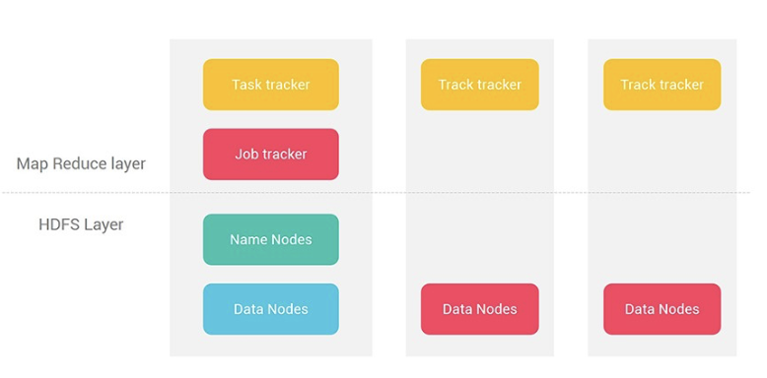
Architecture of Hadoop

Slide 4
HDFS Layer
• HDFS is a fundamental or building block of Hadoop.
Its design is based on Master-Slave Model.
It is having a single Active NameNode and multiple DataNode.
At any given point of time, there will be only one active NameNode.
NameNode and DataNode are basically the server machines.

Slide 5
MapReduce Layer
Processes large datasets using MapReduce efficiently.
Distributes tasks across nodes in parallel manner.
Handles data in key-value pairs during processing.
Uses Map function for data transformation tasks.
Reduce function aggregates results from Map outputs.
Ensures scalability and fault tolerance in computations.

Slide 6
Benefits of HDFS
Fault-tolerant with block replication approach.
Scalable design adapts to growing storage needs.
Optimised for write-once, read-many workloads.
Provides cost-effective distributed file storage.
Manages data efficiently across commodity hardware.
Supports storage for diverse file formats seamlessly.

Slide 7
Benefits of MapReduce
Processes massive datasets with fault tolerance.
Supports scalability for growing data challenges.
Reduces network traffic with data locality features.
Enables efficient parallel computations on clusters.
Enhances performance for big data applications.
Core processing engine in Hadoop ecosystem.

Slide 8
Role of NameNode
Manages HDFS metadata and file structures.
Stores file locations, permissions, and hierarchy.
Directs DataNodes for read/write file operations.
Acts as the master in HDFS architecture.
Stores only metadata, not actual data blocks.
Critical component for Hadoop's storage system.

Slide 9
Role of DataNode
Stores actual data in HDFS block format.
Executes instructions received from Namenode.
Reports block health to Namenode via heartbeat signal.
Manages data replication for fault tolerance.
Acts as the worker node in HDFS system.
Supports distributed data storage across clusters.

Slide 10
Role of Secondary NameNode
Maintains a checkpoint of Namenode data.
Combines edits log and file system image.
Reduces Namenode workload in HDFS.
Prevents log file growth, ensuring efficiency.
Stores metadata snapshot for recovery needs.
Not a backup Namenode for system operations.

Slide 11
Role of Job Tracker
Manages MapReduce jobs submitted to the cluster.
Schedules tasks across nodes for job execution.
Monitors task progress and handles job failures.
Assigns resources using Hadoop YARN framework.
Acts as the master for MapReduce computations.
Ensures efficient task distribution and completion.

Slide 12
Role of Task Tracker
Executes MapReduce tasks assigned by Job Tracker.
Manages individual tasks on a specific node.
Monitors task execution and reports progress.
Handles local input data for faster processing.
Supports fault tolerance by re-running failed tasks.
Ensures efficient use of cluster computational resources.

Slide 13
THANK YOU

